Slide 1
Flavour Hub
Pod 3 - Group 9
Kelly Bearne | Dami Anibaba | Ida Reis | Temi Akindele

Slide 2
Elevator Pitch
Notes:
Hi, we are excited to introduce Flavour Hub, your go-to app for delicious and nutritious meals. With Flavour Hub, you can discover a wide variety of new recipes tailored to your tastes and dietary preferences.
What sets us apart is our commitment to providing detailed nutritional information for every dish, empowering you to make healthier choices effortlessly. Whether you're managing your weight, following a specific diet, or simply aiming for a more balanced lifestyle, Flavour Hub is your trusted companion.
Say goodbye to guesswork and hello to a world of flavorful recipes that nourish your body. Ready to embark on a journey to healthier, tastier living? Try Flavour Hub today!

Slide 3
Concept
Description
An App where its users can get new recipes with the nutritional information. Users will also be able to search for specific recipes that contain specific ingredients.
Motivation for development
Promotes a healthy lifestyle / caters to dietary requirements / recipe variety & inspiration / Educational
User Story
AS a person who likes to cook/a person who is learning how to cook, I WANT TO be able to discover new recipes with the associated nutritional information SO THAT I cook nutritional meals.

Slide 4





Technologies Used
Notes:
Hello everyone, I’m Ida and I’ll be going through the technologies we used: HTML, CSS and Bootstrap for styling, Coolors for the palette chosen, JS for the interactivity and the use of 2 APIs Edamam and Spoonacular.

Slide 5
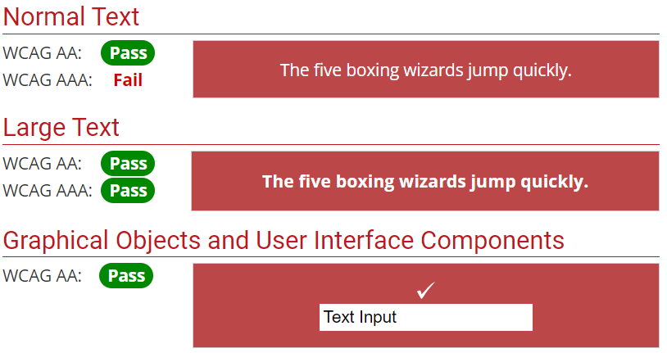
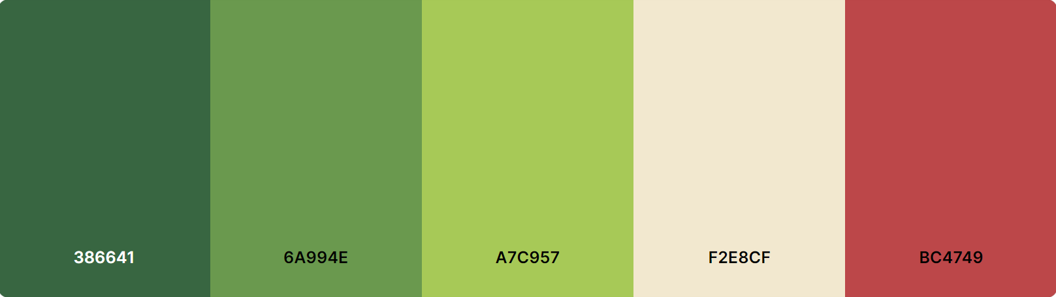
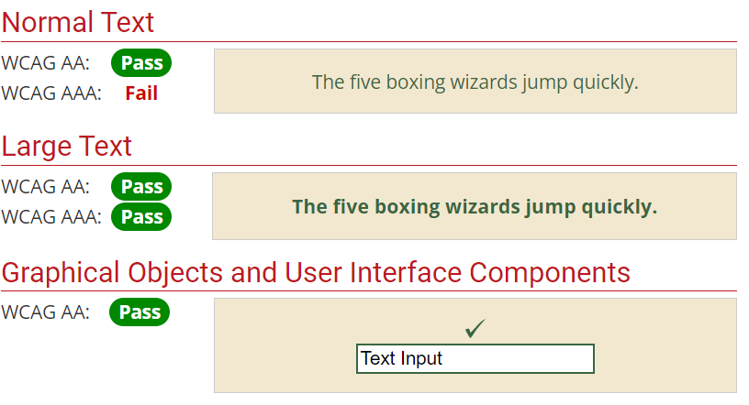
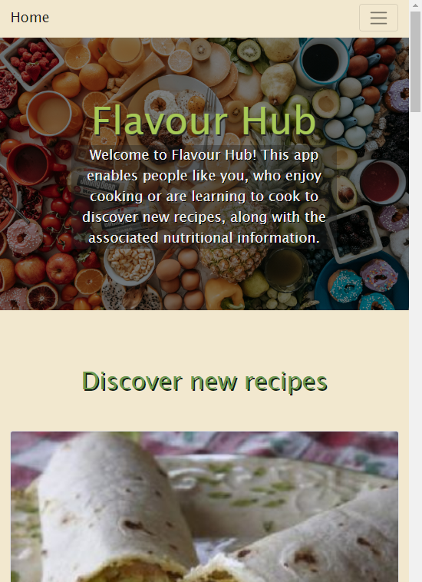
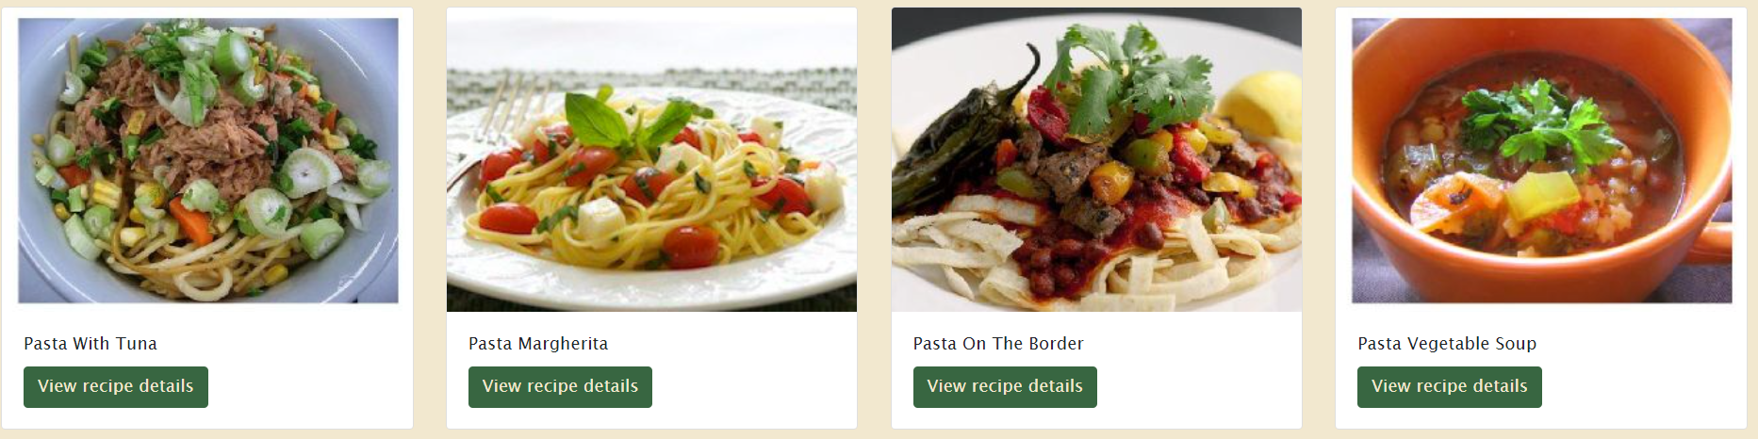
Front End
Accessibility
Colour palette
Responsiveness
Bootstrap cards
Hero Image
Flexbox
Notes:
Starting with the front end, our website has the following colour palette with accessibility and responsiveness in mind. We decided on having different shades of green with 2 accent colours and it passes most accessibility tests. It will work on any device, from your mobile phone to your computer so you always have access to your recipes either at home or on the go. We decided to use bootstrap cards with links that take you to the recipe of choice. And we used buttons and flexbox for the appearance of the ingredients that will pop up for a simple but stylish layout.

Slide 6


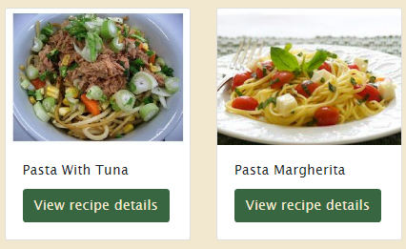
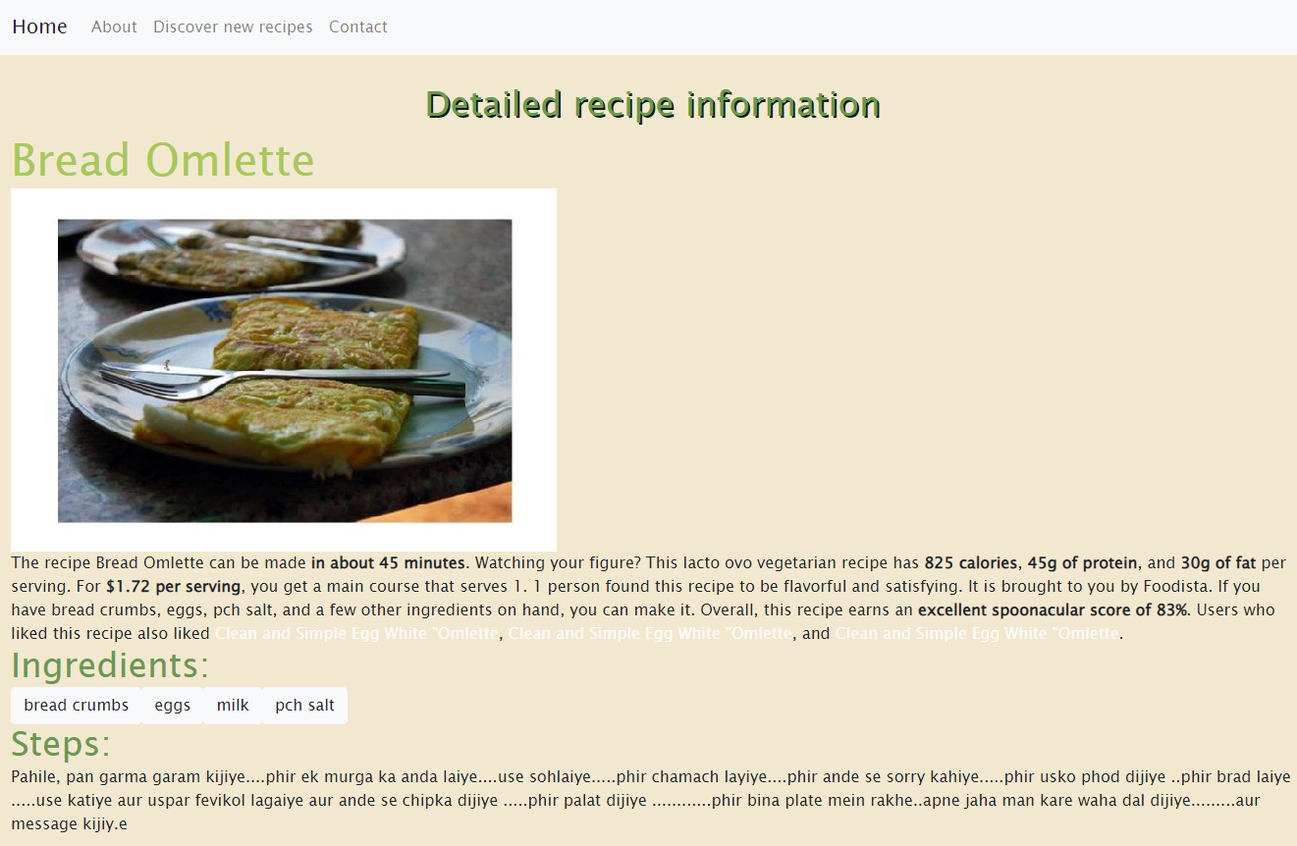
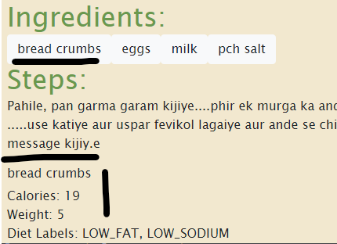
Back End APIs
We utilised two APIs: Spoonacular and Edamam
Plan: Developers free plan - 150 points/day When exploring recipe results, users can click the 'View recipe details' button to access a page with comprehensive information, including a detailed recipe description, ingredients list, and cooking instructions. | Plan: Developers free plan - 100,000 calls/month Ingredients can be clicked which then loads further nutritional information dynamically to the page (including calories, diet labels and item weight).

Slide 7
JavaScript
Local Storage
We used local storage to enhance user experience!
The feature ensure the user search history persists across sessions
The user can easily refer back to their previous searches without losing any data
Utilising Validation
formButton.addEventListener('click', function (event) {
event.preventDefault();
let searchQuery = searchBar.value;
if (searchQuery.trim() === "") {
alert("Value can't be blank, please enter something to search for!");
return;
};
getRecipeInformation(searchQuery);
updateSearchHistory(searchQuery);
populateRecipeInformation(searchQuery);
});
Search
Users can press ‘Enter Key’ or click on the search button to initiate a search
Usage of event listeners to create these actions
We store and display search queries & have a dropdown of previous searches
Default Recipes
A default recipe shows upon the initial page load to enhance engagement
Users are greeted with relevant content right away, setting a positive tone!
Notes:
Local storage
Search bar - how does it work?
Default recipes loading on page
Search queries

Slide 8
Process
17/01/24
18/01/24
19/01/24
Created a proposal and focused on the main structure and layout.
Continued to work on the HTML framework & start on the CSS styling.
Started the CSS styling & merged the HTML formats together. Added the Javascripts elements to the HTML file.
Front-end
Team
Further research into the API’s / pulling of data from the API’s and started the JS pseudo code.
Integrated Edamam API request with Spoonacular recipe output. Populated the README file with the relevant information.
Created a proposal and reviewed initial API documentation.
Back-end
Team
Notes:
When we started the project w decided to split it inti frontend and backend -

Slide 9
Process
Mobile accessibility
Incorporated two API’s
Incorporation of local storage
Worked well as a team!
Finding a viable API source to use.
Formatting the original bootstrap layout in accordance to the wireframe that we originally drafted together.
Debugging API keys
Challenges
Successes

Slide 10
Directions for Future Development
Favourites Page
Allow the user to store favourite recipes so that they can refer back to it later
Allow the user to store favourite recipes in categories
Pseudocode Example
//Initialise favorites from local storage or empty object //Function to add a recipe to favorites
//Event listener for favorite button clicks
//Function to display favorite recipes
//Display favorite on page load
Categories for recipes
Vegetarian
Pescatarian
Vegan
Notes:
And to further enhance the app we..

Slide 11
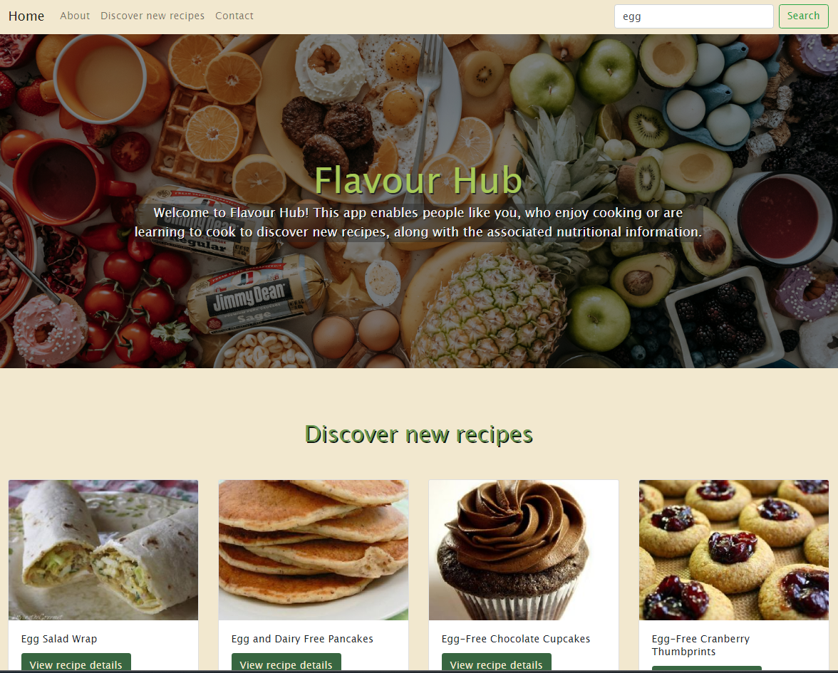

Deployed Page
https://kbearne.github.io/Flavour-Hub/
GitHub Repo
https://github.com/kbearne/Flavour-Hub
Demo

Slide 12
Thank You!

